Slide 1
Presentation 8
Reviews
Review objectives
Formal design reviews (FDRs)
  Participants
  Preparations
  The FDR session
  Post-review activities
Peer reviews (inspections and walkthroughs)
  Participants
  Preparations
  The FDR session
  Post-review activities
  Peer review coverage
Comparison of peer reviews methods
Expert opinions

Slide 2
Review objectives
Direct objectives
a. To detect analysis and design errors as well as subjects
where corrections, changes and completions are required
b. To identify new risks likely to affect the project.
c. To locate deviations from templates, style procedures and
conventions.
d. To approve the analysis or design product. Approval
allows the team to continue on to the next development
phase.
Indirect objectives
a. To provide an informal meeting place for exchange of
professional knowledge about methods, tools and
techniques.
b. To record analysis and design errors that will serve as a
basis for future corrective actions.

Slide 3
Some common formal
design (technical) reviews (DRs)
DPR – Development Plan Review
SRSR – Software Requirement Specification Review
PDR – Preliminary Design Review
DDR – Detailed Design Review
DBDR – Data Base Design Review
TPR – Test Plan Review
STPR – Software Test Procedure Review
VDR – Version Description Review
OMR – Operator Manual Review
SMR – Support Manual Review
TRR – Test Readiness Review
PRR – Product Release Review
IPR – Installation Plan Review

Slide 4
Formal design reviews (FDRs) focus on:
  Participants (review leader + review team)
  Preparations
  The FDR session
  Post-review activities

Slide 5
Characteristics of a DR leader
* Knowledge and experience in development of projects of the type reviewed.
Preliminary acquaintance with the current project is not necessary.
* Seniority at a level similar if not higher than that of the project leader.
* A good relationship with the project leader and his team.
* A position external the project team

Slide 6
Review Team
(Non-project staff to make up the majority of the team)
Senior members of the project
Senior professionals of other projects & departments
Customer-user representatives
Consultants
Team Size: 3-5 members is to be efficient.

Slide 7
Preparations for a DR
Review leader
- Appoints the member
- Schedules the sessions
- Distributes the document
Review team
- To review the document and list the comments (use checklist)
Development team
- To prepare a short presentation of the document.

Slide 8
The Agenda of a DR session
a. A short presentation of the design document.
b. Comments made by members of the review team.
c. Verification and validation of comments is discussed to determine the required action items (corrections, changes and additions).
d. Decisions about the design product (document), which determines the project's progress:
• Full approval.
• Partial approval.
  • Denial of approval.

Slide 9
DR post-review activities
a. Preparation of the DR report.
The report's major sections:
• A summary of the review discussions.
• The decision about continuation of the project.
• A full list of the required action items — corrections,
changes and additions. For each action item, completion
date and project team member responsible are listed.
• The name(s) of the review team member(s) assigned to
follow up.
b. Follow up performance of the corrections and to
examine the corrected sections.

Slide 10
Pressman's 13 golden guidelines
for successful DR - 1
Design Review Infrastructure
· Develop checklists for each or common types of design
documents.
• Train senior professionals serve as a reservoir for DR
teams.
• Periodically analyze past DR effectiveness.
• Schedule the DRs as part of the project plan.
The Design Review Team
. Review teams size should be limited, with 3–5 members
being the optimum.

Slide 11
Pressman's 13 golden
guidelines for successful DR - 2
The Design Review Session
Discuss professional issues in a constructive way refraining
from personalizing the issues.
Keep to the review agenda.
Focus on detection of defects by verifying and validating the
participants' comments. Refrain from discussing possible solutions.
In cases of disagreement about an error - end the debate by
noting the issue and shifting its discussion to another forum.
Properly document the discussed comments, and the results of
their verification and validation.
The duration of a review session should not exceed two hours.
Post-Review Activities
Prepare the review report, including the action items
Establish follow-up procedure to ensure the satisfactory performance of all the list of action items

Slide 12
Participants of peer reviews
Inspection
(more formal)
Walkthrough
Review leader
The author
Specialized professionals:
  Designer
  Coder or implementer
  Tester
Review leader
The author
Specialized professionals:
  Standards enforcer
  Maintenance expert
  User representative

Slide 13
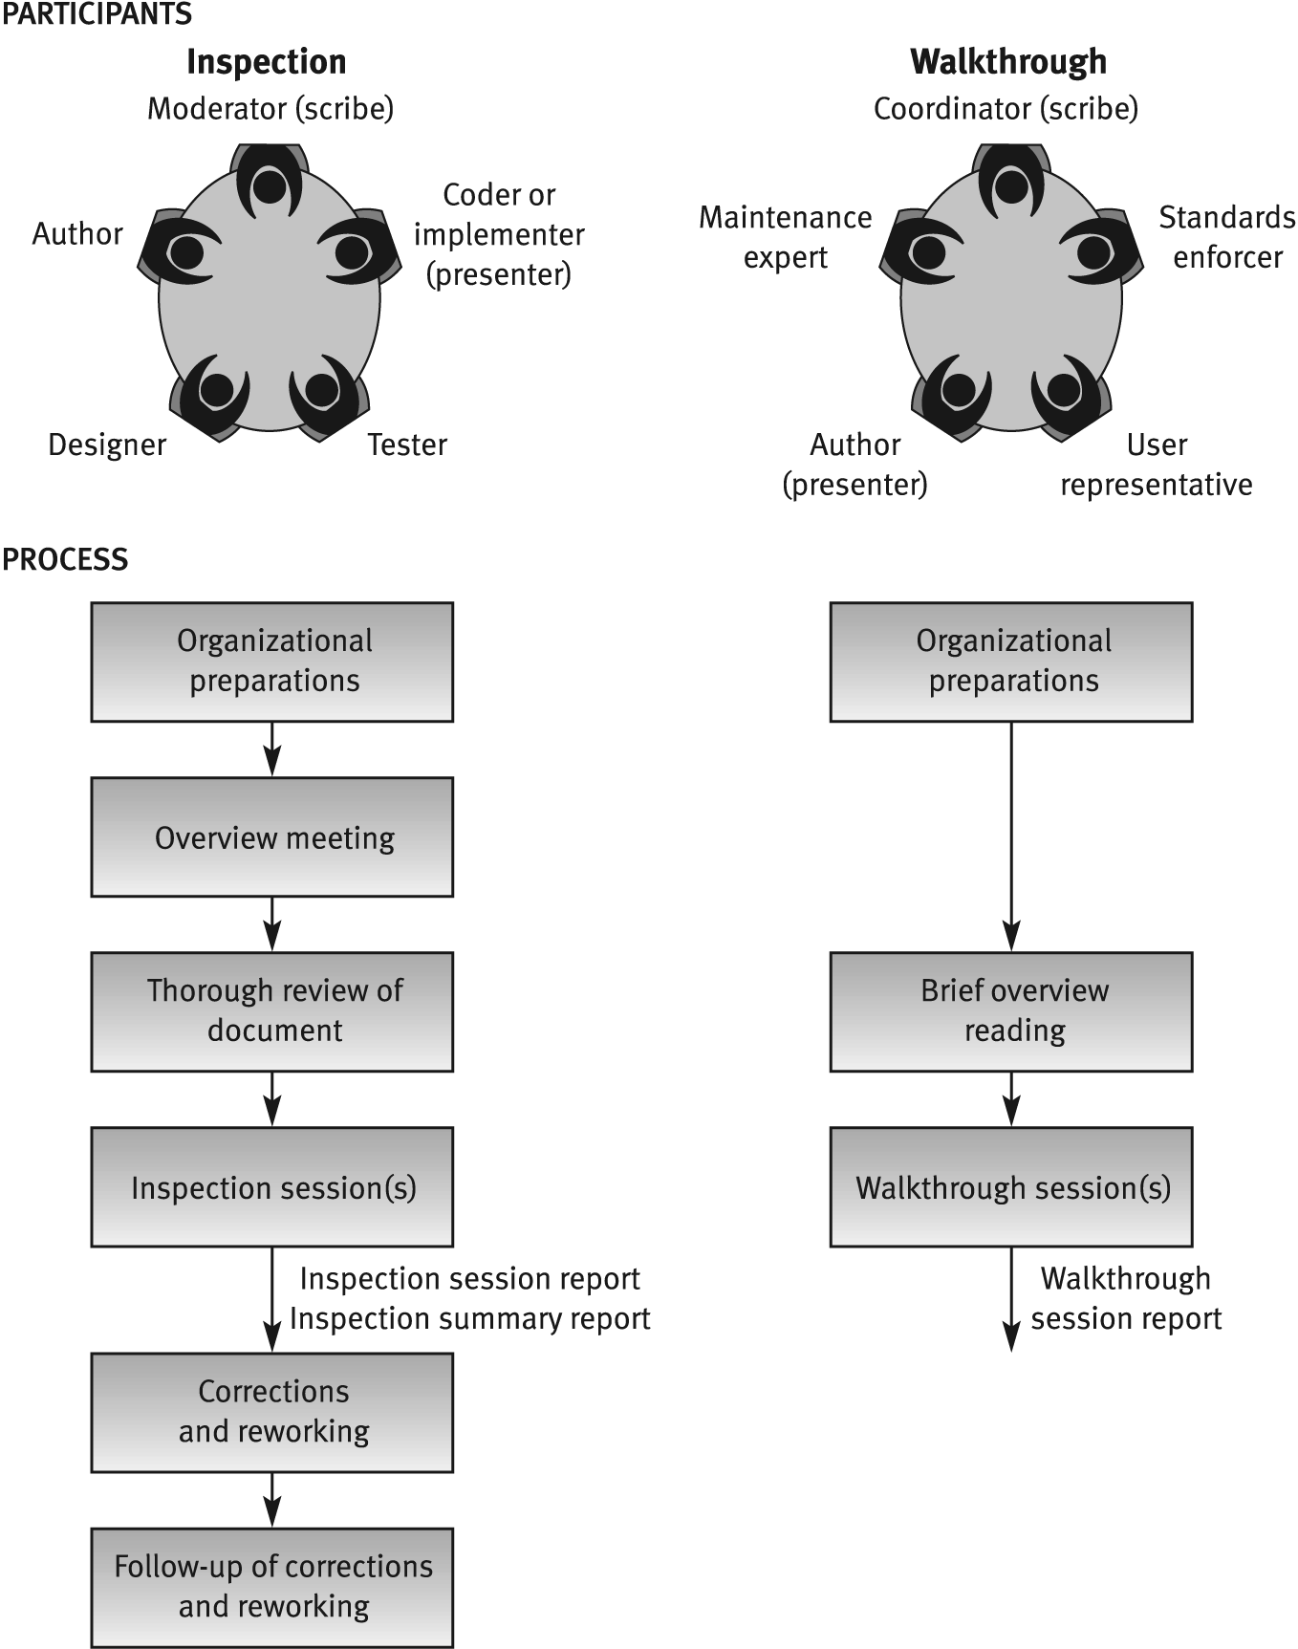
Inspection vs. Walkthrough

Slide 14
Code inspection effectiveness
at Fujitso (Cusumano)
Year
Defect detection method
Defects per 1000 lines of maintained code
Test
%
Design review
%
Code inspection
%
1977
85
---
15
0.19
1978
80
5
15
0.13
1979
70
10
20
0.06
1980
60
15
25
0.05
1981
40
30
30
0.04
1982
30
40
30
0.02

Slide 15
Sections recommended to be
included in or omitted from
peer reviews
Sections recommended for inclusion
Sections of complicated logic
Critical sections, where defects severely damage essential system capability
Sections dealing with new environments
Sections designed by new or
inexperienced team members
Sections recommended for omission
“Straightforward” sections (no complications)
Sections of a type already reviewed by the team in similar past projects
Sections that, if faulty, are not expected to effect functionality
Reused design and code
Repeated parts of the design and code

Slide 16
Comparison of review
methodologies -
Process of review
Properties | Design review | Inspection | Walkthrough
Overview meeting | No | Yes | No
Participant’s preparations | Yes - thorough | Yes - thorough | Yes - brief
Review session | Yes | Yes | Yes
Follow-up of corrections | Yes | Yes | No
Formal training of participants | No | Yes | No
Participant’s use of checklists | No | Yes | No
Error-related data collection | Not formally required | Formally required | Not formally required
Review documentation | Formal design review report | 1) Inspection session findings report 2) Inspection session summary report

Slide 17
Situations beneficial for expert's
participation in reviews
• Insufficient in-house professional capabilities in a specialized area.
• Temporary lack of in-house professionals for review team.
• Indecisiveness caused by major disagreements among the organization’s senior professionals.
• In small organizations, where the number of suitable candidates for a review team is insufficient.

